Slide 1
Thales Stock Predictor
DBAS3090
Applied Data Analytics Project
James Laurence – W0211593

Slide 2
AGENDA
Introduction
Data Sources
Tools and Software
Project Schedule
Key Performance Indicators
Conclusion

Slide 3
INTRODUCTION
The Thales Stock Price Prediction project aims to provide valuable insights to both current Thales stockholders and prospective investors. By leveraging predictive modeling techniques, this project will forecast Thales’ stock prices, enabling informed investment decisions.

Slide 4
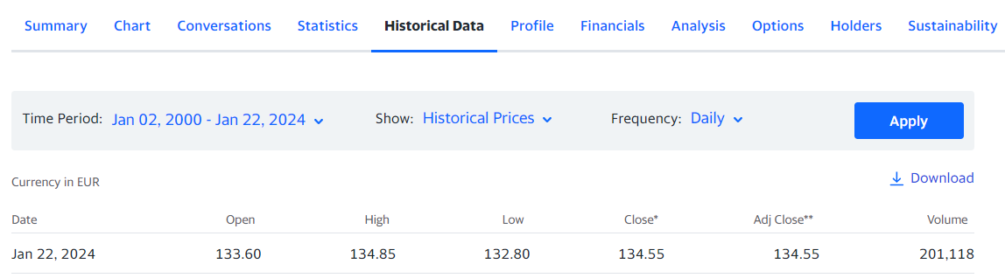
Data sources
Yahoo Finance – Daily Historical Dataset
Thales Stock (HO.PA)
France Based Security Company (Euro)
https://ca.finance.yahoo.com/quote/HO.PA/?p=HO.PA
Standard & Poor 500
Quarterly Dividend Index (USD)
https://ca.finance.yahoo.com/quote/SDI%3DF/?p=SDI%3DF
CAC 40 (FCHI)
France Market Index (Euro)
https://ca.finance.yahoo.com/quote/%5EFCHI/?p=%5EFCHI
Dax Performance (GDAXI)
European Market Index (Euro)
https://ca.finance.yahoo.com/quote/%5EGDAXI/?p=%5EGDAXI

Slide 5
Tools and software
Documentation:
Microsoft Office 365, Microsoft Project
Database Development:
Visual Paradigm, Microsoft Visio, Microsoft SQL Server
Data Processing (ETL):
PowerShell, Microsoft Visual Studio, Microsoft SQL Server Integration Services,
Python (Pandas, Numpy, Scikit-learn, Tensorflow), R
Visualization
Microsoft Power BI, Python (Matplotlib, Seaborn)
Reporting:
Microsoft Power BI, Report Builder, Report Server

Slide 6
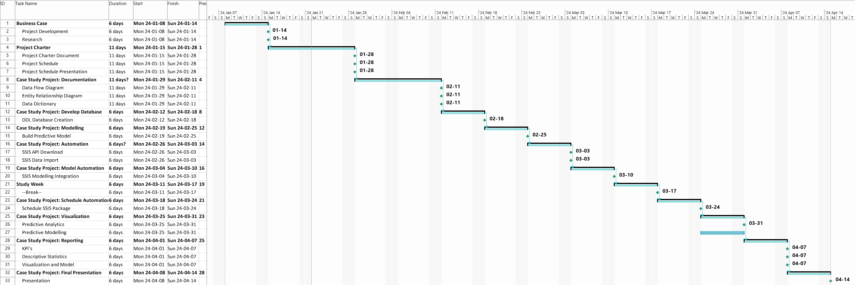
Project schedule

Slide 7
Key Performance Indicators
Descriptive Statistics:
Dynamically summarize key dataset features each the dataset has been updated.
Target: Display Descriptive Statistics in interactive dashboard and report.
Predictive Model Accuracy:
Measure the accuracy of the predictive model against current market values using Mean Absolute Error (MAE), Root Mean Squared Error (RMSE), or R-squared value.
Target: Achieve a prediction accuracy rate of at least 80% over the specified time-period.
Return on Investment:
Based on the predictions of the model, relative to the amount of money invested. It is usually expressed as a percentage.
Target: Achieve a positive ROI, indicating that the gains made on the stock, based on model predictions, outweigh the initial cost of investment with a minimum ROI of 10%.
Compound Annual Growth Rate:
Provides a normalized view of the investment's growth, smoothing out the effects of volatility and providing a compounded annual rate of return.
Target: Conservative Growth – Achieve a specific CAGR of 5% minimum.
Target: Moderate Growth – Achieve a specific CAGR of 8% to 10% minimum.

Slide 8
Key Performance Indicators
Moving Average Crossing:
Integration: Utilize moving averages as features in your predictive model.
Target Alignment: Track the frequency and accuracy of stock prices crossing the moving average. Higher accuracy indicates better prediction of price movements.
Bollinger Bands Width:
Integration: Include Bollinger Bands width as a feature in your predictive model.
Target Alignment: Assess the width of Bollinger Bands to identify periods of volatility. A wider width during market fluctuations can indicate increased volatility.
On-Balance Volume Trend Confirmation:
Integration: Incorporate On-Balance Volume (OBV) as a feature in your predictive model.
Target Alignment: Confirm the trend direction using OBV and aim for a high correlation between OBV trends and subsequent stock price movements.
Relative Strength Index:
Integration: Integrate RSI values as features in your predictive model.
Target Alignment: Measure the accuracy of RSI in identifying overbought or oversold conditions. A higher accuracy rate indicates better prediction of price reversals.

Slide 9
Thank you. Questions?

